Slide 1


Crook County Sheriff’s Office
MISSION STATEMENT
"We work in partnership with our citizens to preserve life, protect property, hold offenders accountable and conserve the peace"
VISION STATEMENT
It is the vision of Crook County Sheriff's Office to be a team of respected and innovative professionals committed to continuous improvement of our community through:
*Effective and efficient public safety service
*Safe, secure and efficient incarceration facility
*Communication with our citizens
MOTTO
"HONOR * SERVICE * JUSTICE"
"ABOVE ALL INTEGRITY"

Slide 2
The purpose and scope of discussion is to provide evidence based information of known and/or forecasted Sheriff’s Office operational needs. To further introduce a planning discussion of how to responsibly/fiscally plan and execute assessed budgetary, staffing, and retention needs.

Slide 3
Increased calls for service levels; up 46%
Diminished self-initiated activities / proactive policing; down 19%
Increased criminal activities / UCR [State] Crime Reporting; CCSO up 41%
Significant increase in Jail overtime – up 100%
Position vacancies covered by patrol
Preliminary wage study indicates that the County is lagging in some areas and leading in others. Full study available when complete
Key statistical data

Slide 4
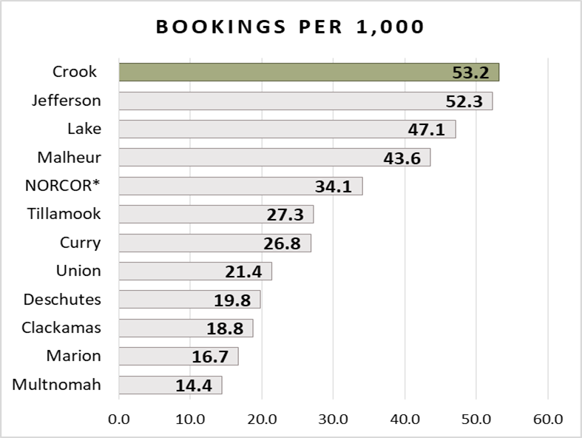
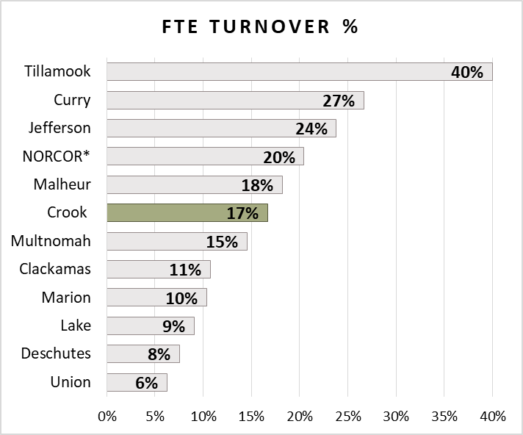
Jail Statistics

Slide 5
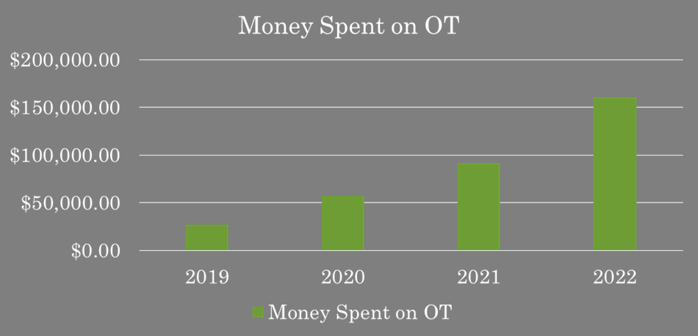
Jail Statistics

Slide 6
Jail Staffing
Current Jail Staffing
Recommended Jail Staffing
Administration
Sheriff
Adminstration Undersheriff
Administration Jail Lieutenant
[2]
Team 2
Jail Sergeant
[1]
Team 1
Jail Sergeant/Vacant
[5]
Deputy
[6]
Deputy
[3]
Team 3
Jail Corporal
[9]
Deputy
[4]
Team 4
Jail Corporal
[13]
Deputy
[17]
Control
[10]
Deputy
[14]
Deputy/Vacant
[18]
Control
[7]
Deputy
[11]
Deputy
[15]
Deputy/Vacant
[19]
Control/Vacant
[8]
Deputy
[12]
Deputy
[16]
Control
[20]
Control/Vacant
[New]
Office Deputy
Office Deputy
[22]
Apr 23 Deputy
[21]
Control/Vacant
Court Security
Transition Deputy
[23]
Apr 23 Deputy
Administration
Sheriff
Adminstration Undersheriff
Administration Jail Lieutenant
[2]
Team 2
Jail Sergeant
[1]
Team 1
Jail Sergeant
[5]
Deputy
[6]
Deputy
[3]
Team 3
Jail Corporal
[9]
Deputy
[4]
Team 4
Jail Corporal
[13]
Deputy
[17]
Deputy/Control
[10]
Deputy
[14]
Deputy
[18]
Deputy/Control
[7]
Deputy
[11]
Deputy
[15]
Deputy
[19]
Deputy/Control
[8]
Deputy
[12]
Deputy
[16]
Deputy/Contro
[20]
Deputy/Control
[New]
Office Deputy
Office Deputy
[22]
Apr 23 Deputy
[21]
Deputy/Control
[24]
New Deputy
Court Security
Transition Deputy
[23]
Apr 23 Deputy

Slide 7
Jail Summary
Additional new ask seven [7] FTE.
Technical Deputy conversion to floor Deputy est. cost $240k initial cost.
$120k per year maintenance cost for 9 new FTE.
1 additional deputy needed
1 office manager w/equipment $120k

Slide 8
Patrol Statistics
18.7% decrease
Additional deputy ask 42%

Slide 9
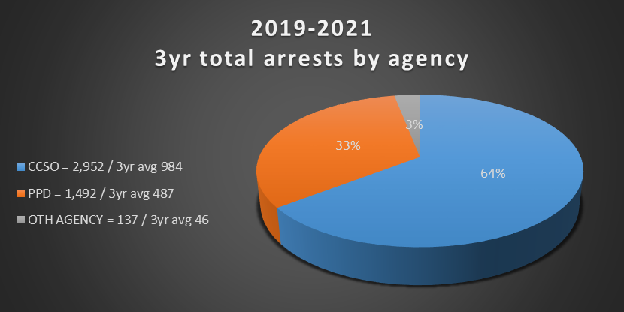
Patrol Statistics
CCSO responsible for
64% of the arrests within the County
State UCR Crime Reporting
41%
CCSO

Slide 10
Patrol Staffing
Current Patrol Staffing
Recommended minimum staffing
Administration
Sheriff
Adminstration Undersheriff
Administration Patrol Lieutenant
[2]
Team 2
Patrol Sergeant
[1]
Team 1
Patrol Sergeant
[5]
Deputy
[6]
Deputy
[3]
Team 3
Patrol Sergeant
[9]
Deputy
[4]
Team 4
Patrol Sergeant
[13]
Deputy
[10]
Deputy
[14]
Deputy
[7]
Deputy
[11]
Deputy
[15]
Deputy
[8]
Deputy
[12]
Deputy
Evidence Tech
Office Deputy
[16]
Criminal Detective
CODE DETECTIVE
Reallocated to Patrol
CSO
Civil Deputy
Administration
Sheriff
Adminstration Undersheriff
Administration Patrol Lieutenant
[2]
Team 2
Patrol Sergeant
[1]
Team 1
Patrol Sergeant
[5]
Deputy
[6]
Deputy
[3]
Team 3
Patrol Sergeant
[9]
Deputy
[4]
Team 4
Patrol Sergeant
[13]
Deputy
[New]
Deputy
[10]
Deputy
[14]
Deputy
[New]
Deputy
[7]
Deputy
[11]
Deputy
[15]
Deputy
[New]
Deputy
[8]
Deputy
[12]
Deputy
[New]
Deputy
[New]
Deputy
[New]
Office Deputy
Evidence Tech
Office Deputy
SAR
COMMANDER
[Double Fill]
[16]
Criminal Detective
CODE DETECTIVE
VACANT
[New]
Criminal Detective
CSO
Civil Deputy

Slide 11
Patrol Summary
6 patrol deputy [loaded] / 120k x 6 = 720k
6 patrol vehicles w/equipment / 110k x 6 = 660k
6 FTE equipment cost; initial setup expense / 30k x 6 = 180k
1 office deputy w/equipment 87k

Slide 12
Justice Center Needs
Meet with County Court and Circuit Court to determine needs assessment.

Slide 13
Summary by fiscal year
Jail
Patrol
2023
  240k tech conversion
  120k office manager
  Total 360k
2024
  120k deputy wage
  120k new deputy
  Total 240k
2025
  No projected additional outside collective bargaining agreement
2023
  780k 3 deputies w/equipment
  87k office deputy
  Total 867k
2024
  780k 3 deputies w/equipment
  447k maintenance cost
  Total 1.2m
2025
  360k maintenance for deputies

Slide 14
Questions

