Slide 1
Community Development
Mission
The Community Development Department's mission, through the collaborative efforts of its building safety, land use, onsite (septic), and code compliance programs, is to enhance the quality of life for all residents by applying the required development standards to safeguard life, health, property, and public welfare, while encouraging innovation, sustainable communities, and the preservation of the unique character of Crook County.
Major goals
Update to the Transportation System Plan (TSP)
Finalize and implement strategic plan
Research technology enhancements
Digital plan review (implement FY 2025)
Alternative document management software for better public interface and use by staff in field
Review and update department fees
Create plan for state-of-the-art community development facility
Consider options for updating comprehensive plan in fiscal year 2025
Notes:
Enter your department in Header area
Enter the department’s mission statement
Enter the department’s major goals/work plan elements
Add the department logo to bottom left corner, same size as County logo

Slide 2
Community Development Financial Summary amounts in thousands
 | Budget | Actual | Variance
Beginning balance | $ 10,652 | $ 10,487 | $ (165)
Revenue | 1,047 | 655 | (392)
Expenses | 1,278 | 939 | 339
Ending balance | $ 10,421 | $ 10,203 | $ (218)
Comments
Fee dependent department; permit activity has slowed, lowering revenue
Personnel expenses down due to not being fully staffed
Notes:
Enter department in header
Enter the department’s quarterly budget, actual and variance amounts ---- in thousands
Enter comments to explain any significant variances
Add the department’s logo to the bottom left corner, same size as County logo

Slide 3
Community Development Activities Q1 FY 2024
Goal/work plan description | Activity during quarter | Comments
Update TSP | Project management team held meetings; first PAC meeting held in November 2023 | Public outreach efforts ongoing, including two open houses in mid-February
Finalize Strategic Plan | County Court approved the Strategic Plan on December 20, 2023 | CDD will move forward with implementing the plan
Technology Enhancements | None | Building is ready for digital plan review requirements in 2025; will look to acquire new hardware and software at time CDD relocates
Notes:
Replace “Department” with your department name in header
List the major goals/work plan elements for the department
Provide a brief description of activity on each goal/work plan item
List any challenges or changes or other comments for each goal/work plan item
Add additional lines as needed – go to next page if needed
If additional page added, delete “Questions”
Add department logo to left of the County logo – same size as County logo

Slide 4
Community Development Activities - continued Q1 FY 2024
Goal/work plan description | Activity during quarter | Comments
Review and update fees | Regular consideration of where fees can be adjusted to cover actual cost | Will continue to review and update fees annually; if funding available, will conduct detailed fee study
Plan for new CDD facility | CDD Director attended regular meetings to consider new building options
Consider options for comprehensive plan update | None | Funding dependent, will retain consultant to audit existing comp plan and provide recommendations on best process for update
Notes:
Replace “Department” with your department name in header
Continue your list of the major goals/work plan elements
Provide a brief description of activity on each goal/work plan item
List any challenges or changes or other comments for each goal/work plan item
Add additional lines as needed – go to next page if needed
If additional page added, delete “Questions”
Add your department logo to left of the County logo – same size as County logo

Slide 5
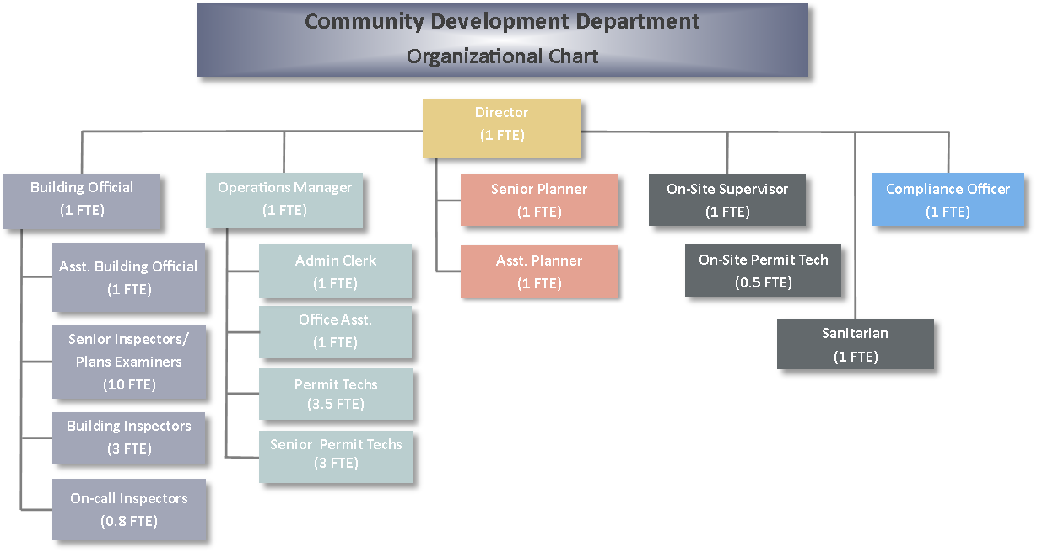
Community Development Staffing Summary
Comments:
One building inspector relocated our of state during Q2
Given the state of the economy, CDD is acting conservative as to filling open positions
Org Chart
Staffing Summary
Authorized | Filled | Vacancies
32.8 | 24.8 | 8.0
Notes:
Enter department in the bottom header
Enter the department’s organization chart
Provide some bullets describing personnel during the quarter, e.g., number of new employees, separations, etc.any pending recruitments, significant new hires or seprarations
Enter the department’s authorized, filled and vacate positions – FTEs as of end of the quarter
Add the department logo to the left of the County logo – same size as County logo

Slide 6
Community Development Performance Measures Q1 FY 2024
Performance measure | Goal | Actual | Comments
[BLD] Perform requested inspections within one (1) business day. [CE] Close cases within 90 days of receipt of complaint. [ONS] Perform requested inspections with one (1) business day. Respond to email inquiries and voicemails within one to 3 (1-3) business days. [PLN] Issue all administrative decisions requiring notice (with no hearing) within 30 days of completed applications. | 95% 60% 75% 100% 100% |  | Will begin tracking after adoption of strategic plan Going forward, as part of monthly update to County Court, CDD will include data regarding performance measures.
Questions
Notes:
Replace “Department” with your department name in header
Enter performance measures, goal and actual, with comments --- use performance measures included in the budget as a starting point, additional measures are encouraged
Add your department logo to left of the County logo – same size as County logo

