Slide 1
Health & Human Services
Mission
Crook County Public Health strives to provide fair opportunity for those in our community to achieve their full health potential.
Major goals
1. Administrative integration of services and process improvements
2. Fiscal efficiency and sustainability
3. Communications process improvements and capacity
4. Facilities planning
Notes:
Enter your department in Header area
Enter the department’s mission statement
Enter the department’s major goals/work plan elements
Add the department logo to bottom left corner, same size as County logo

Slide 2
Health & Human Services Financial Summary amounts in thousands
 | Budget | Actual | Variance
Beginning balance | $4,179 | $2,610 | ($1,596)
Revenue | $1,890 | $1,299 | ($591)
Expenses | $2,194 | $1,925 | $269
Ending balance | $3,875 | $1,985 | ($1,890)
Comments
Health
Notes:
Enter department in header
Enter the department’s quarterly budget, actual and variance amounts ---- in thousands
Enter comments to explain any significant variances
Add the department’s logo to the bottom left corner, same size as County logo

Slide 3
Health & Human Services Financial Summary amounts in thousands
 | Budget | Actual | Variance
Beginning balance | $223 | $239 | $16
Revenue | $24 | $2 | $(22)
Expenses | $71 | $32 | $39
Ending balance | $176 | $209 | $33
Comments
Veterans
Notes:
Enter department in header
Enter the department’s quarterly budget, actual and variance amounts ---- in thousands
Enter comments to explain any significant variances
Add the department’s logo to the bottom left corner, same size as County logo

Slide 4
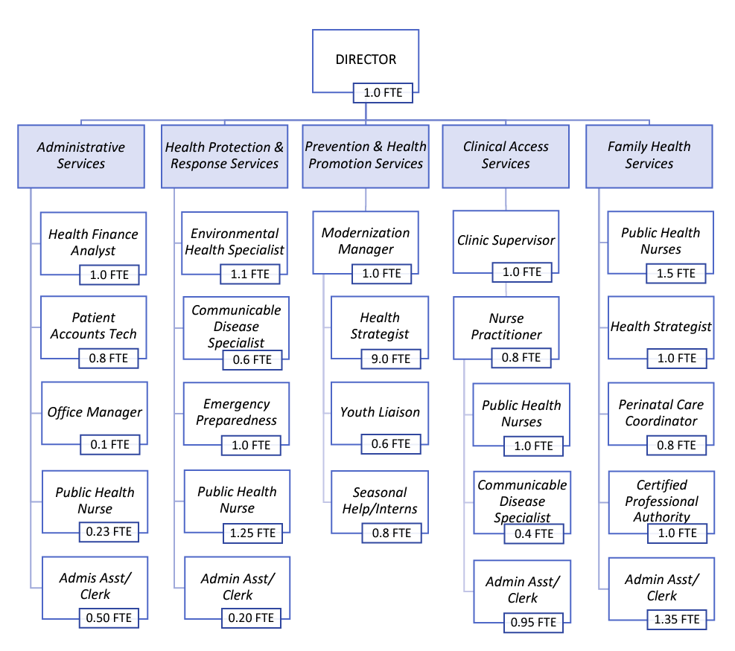
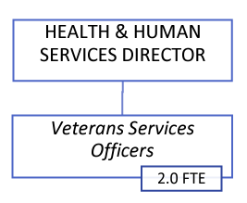
Health & Human Services Staffing Summary
Comments:
1.0 Administrative Assistant
1.0 Veteran Services Officer
Org Chart
Staffing Summary
Authorized | Filled | Vacancies
2.0 | 2.0 | 0.0
Authorized | Filled | Vacancies
28.98 | 26.3 | (2.68)
Notes:
Enter department in the bottom header
Enter the department’s organization chart
Provide some bullets describing personnel during the quarter, e.g., number of new employees, separations, etc.any pending recruitments, significant new hires or seprarations
Enter the department’s authorized, filled and vacate positions – FTEs as of end of the quarter
Add the department logo to the left of the County logo – same size as County logo

Slide 5
Department Activities Q1 FY 2024
Goal/work plan description | Activity during quarter | Comments
Update and/or develop training for technology and operations by April 2024 Integrate Veteran Services processes and procedures into Health & Human Services by June 2024. | Q2 rollout of purchasing and communications processes Training/Professional development draft automation VSO training VSO leadership & events/outreach committee, Admin QI
Reorganize chart of accounts by October 2023. Increase FY24 federal and state funding resources by 5%. | Successful reorganization of department chart of accounts in Q1 All grant proposals submitted include direct expenses that support internal services
Notes:
Replace “Department” with your department name in header
List the major goals/work plan elements for the department
Provide a brief description of activity on each goal/work plan item
List any challenges or changes or other comments for each goal/work plan item
Add additional lines as needed – go to next page if needed
If additional page added, delete “Questions”
Add department logo to left of the County logo – same size as County logo

Slide 6
Department Activities - continued Q1 FY 2024
Goal/work plan description | Activity during quarter | Comments
Review and revise department communication plans by April 2024 Increase dedicated capacity to effectively implement communication plans by June 2024 | Prevention communications contract drafted Department communications solicitation in progress
Develop facilities plan for department by April 2024 | Regular communication with Mosaic Medical re: current lease and ongoing partnership with facilities
Notes:
Replace “Department” with your department name in header
Continue your list of the major goals/work plan elements
Provide a brief description of activity on each goal/work plan item
List any challenges or changes or other comments for each goal/work plan item
Add additional lines as needed – go to next page if needed
If additional page added, delete “Questions”
Add your department logo to left of the County logo – same size as County logo

Slide 7
Department Performance Measures Q1 FY 2024
Veteran Services
Performance measure | Goal | Actual | Comments
On track to file 150 claims in 2024 by June 2024 | 75 |  | Tracked in VetraSpec Will begin monitoring in January 2024
Conduct weekly outreach with partners and among the public. | 52 |  | Will begin January 2024
Notes:
Replace “Department” with your department name in header
Enter performance measures, goal and actual, with comments --- use performance measures included in the budget as a starting point, additional measures are encouraged
Add your department logo to left of the County logo – same size as County logo

Slide 8
Department Performance Measures Q1 FY 2024
Communicable Disease
Performance measure | Goal | Actual | Comments
Percent of two-year olds who received recommended vaccines | 78.6% | 70% | Percent of Vaccines For Children Number of clinics that participate in the Assessment, Feedback, Incentives, and eXchange (AFIX) program
Gonorrhea incidence rate per 100,000 population | 86 cases/100,000 for women 15-44 | 85.5/100,000 | Percent of gonorrhea cases that had at least one contact that received treatment Percent of gonorrhea case reports with complete priority fields
Notes:
Replace “Department” with your department name in header
Enter performance measures, goal and actual, with comments --- use performance measures included in the budget as a starting point, additional measures are encouraged
Add your department logo to left of the County logo – same size as County logo

Slide 9
Department Performance Measures Q1 FY 2024
Environmental Health
Performance measure | Goal | Actual | Comments
Percent of commuters who walk, bike, or use public transportation to get to work | None | N/A | Local public health authority participation in leadership or planning initiatives related to active transportation, parks and recreation, or land use
Percent of community water systems that meet health-based standards | 92% |  | Percent of water systems surveys completed Percent of water quality alert responses Percent of priority non-compliers resolved
Notes:
Replace “Department” with your department name in header
Enter performance measures, goal and actual, with comments --- use performance measures included in the budget as a starting point, additional measures are encouraged
Add your department logo to left of the County logo – same size as County logo

Slide 10
Department Performance Measures Q1 FY 2024
Prevention & Health Promotion
Performance measure | Goal | Actual | Comments
Adults who smoke cigarettes | 15% | 18% | Percent of population reached by tobacco-free county properties policies Percent of population reached by tobacco retail licensure policies
Opioid-related overdose deaths | <3/100,000 |  | Percent of top opioid prescribers enrolled in the Prescription Drug Monitoring Program (PDMP) database
Notes:
Replace “Department” with your department name in header
Enter performance measures, goal and actual, with comments --- use performance measures included in the budget as a starting point, additional measures are encouraged
Add your department logo to left of the County logo – same size as County logo

Slide 11
Department Performance Measures Q1 FY 2024
Access to Clinical Preventive Services
Performance measure | Goal | Actual | Comments
Effective contraceptive use among women at risk of unintended pregnancy | 50% |  | Annual strategic plan that identifies gaps, barriers, and opportunities for improving access to effective contraceptive use
Percent of children age 0-5 with any dental visit | 47.2
Questions
Notes:
Replace “Department” with your department name in header
Enter performance measures, goal and actual, with comments --- use performance measures included in the budget as a starting point, additional measures are encouraged
Add your department logo to left of the County logo – same size as County logo

